Slide 1
TREES

Slide 2
TREE
A tree is a data structure consisting of nodes organized as a hierarchy.
In Tree nodes are connected by edges.
A tree is a nonlinear data structure, compared to arrays, linked lists, stacks and queues which are linear data structures.
A tree is a collection of nodes connected by directed (or undirected) edges.
The collection can be empty, which is sometimes denoted as A.
Otherwise, a tree consists of a distinguished node r, called the root, and zero or more (sub)trees T1, T2, . . . , Tk, each of whose roots are connected by a directed edge to r.
The root of each subtree is said to be a child of r, and r is the parent of each subtree root.

Slide 3
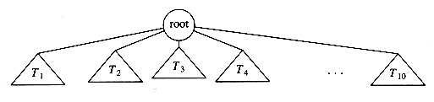
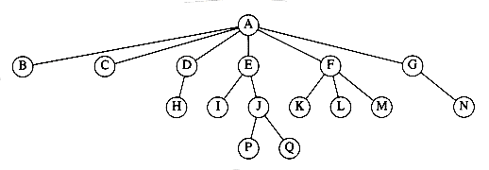
Figure shows a typical tree using the recursive definition.
From the recursive definition, we find that a tree is a collection of n nodes, one of which is the root, and n - 1 edges.
That there are n - 1 edges follows from the fact that each edge connects some node to its parent, and every node except the root has one parent (see Fig.).

Slide 4
In the tree of Figure, the root is A.
Node F has A as a parent and K, L, and M as children.
Each node may have an arbitrary number of children, possibly zero.
Nodes with no children are known as leaves; the leaves in the tree are B, C, H, I, P, Q, K, L, M, and N.
Nodes with the same parent are siblings; thus K, L, and M are all siblings.
Grandparent and grandchild relations can be defined in a similar manner.

Slide 5
Terminologies used in Trees
Root − Node at the top of the tree is called root. There is only one root per tree.
Parent − Any node except root node has one edge upward to a node called parent.
Child − Node below a given node connected by its edge downward is called its child node.
Leaf − Node which does not have any child node is called leaf node.
Path − Path refers to sequence of nodes along the edges of a tree.
A path from node n1to nk is defined as a sequence of nodes n1, n2, .. . , nk such that ni is the parent of ni+1for 1 i < k.
The length of this path is the number of edges on the path, namely k -1. There is a path of length zero from every node to itself.
Notice that in a tree there is exactly one path from the root to each node.
Siblings - A group of nodes with the same parent.

Slide 6
Subtree − Subtree represents descendants of a node.
Degree - The number of sub trees of a node.
Height of node - The height of a node is the number of edges on the longest path between that node and a leaf.
The height of ni is the longest path from ni to a leaf.
Thus all leaves are at height 0.
Height of tree - The height of a tree is the height of its root node.
Depth - The depth of a node is the number of edges from the node to the tree's root node.
For any node ni, the depth of ni is the length of the unique path from the root to ni.
Thus, the root is at depth 0.
Levels − Level of a node represents the generation of a node. If root node is at level 0, then its next child node is at level 1, its grandchild is at level 2 and so on.
Forest - A forest is a set of n ≥ 0 disjoint trees.

Slide 7
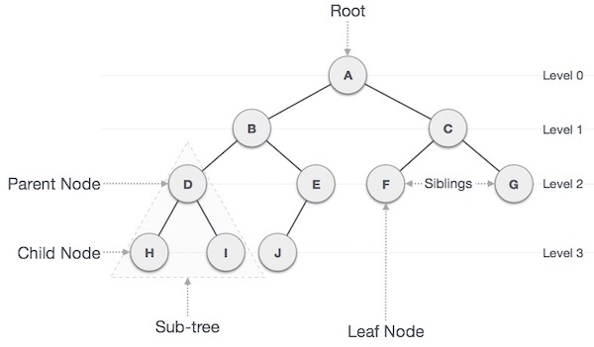
Figure courtesy : https://www.tutorialspoint.com/data_structures_algorithms/tree_data_structure.htm

Slide 8
Binary Trees
A binary tree is a tree in which no node can have more than two children.
A binary tree is a tree data structure in which each node has at most two children, which are referred to as the left child and the right child.
Figure shows that a binary tree consists of a root and two subtrees, Tl and Tr, both of which could possibly be empty.

Slide 9
Types of binary trees
1. Full Binary Tree:
A full binary tree is a tree in which every node in the tree has either 0 or 2 children.
A binary tree is full if each node is either a leaf or possesses exactly two child nodes.

Slide 10
2. Complete Binary Tree:
A Binary Tree is complete Binary Tree if all levels are completely filled except possibly the last level and the last level has all keys as left as possible.
A binary tree with n levels is complete if all levels except possibly the last are completely full, and the last level has all its nodes to the left side..

Slide 11
3. Perfect Binary Tree:
A Binary tree is Perfect Binary Tree in which all internal nodes have two children and all leaves are at same level.
A binary tree is a perfect binary tree if and only if :-
is a full binary tree
All leaf nodes are at the same level

Slide 12
Properties of Full binary trees
Let T be a nonempty, full binary tree Then:
(a) If T has I internal nodes, the number of leaves is L = I + 1.
(b) If T has I internal nodes, the total number of nodes is N = 2I + 1.
(c) If T has a total of N nodes, the number of internal nodes is
I = (N – 1)/2.
(d) If T has a total of N nodes, the number of leaves is L = (N + 1)/2.
(e) If T has L leaves, the total number of nodes is N = 2L – 1.
(f) If T has L leaves, the number of internal nodes is I = L – 1.
The number of nodes N in a full binary tree, is at least N=2^{h}+1 and at most N=2^{h+1}-1, where h is the height of the tree.
A tree consisting of only a root node has a height of 0.

Slide 13
Implementation
Because a binary tree has at most two children, we can keep direct pointers to them.
The declaration of tree nodes is similar in structure to that for doubly linked lists, in that a node is a structure consisting of the key information plus two pointers (left and right) to other nodes.
struct node
{
int data;
struct node * left_ptr;
struct node * right_ptr;
};

Slide 14
Expression Trees
The leaves of an expression tree are operands, such as constants or variable names,and the other nodes contain operators.
This particular tree happens to be binary, because all of the operations are binary.
It is also possible for a node to have only one child, as is the case with the unary minus operator.
We can evaluate an expression tree, T, by applying the operator at the root to the values obtained by recursively evaluating the left and right subtrees.

Slide 15
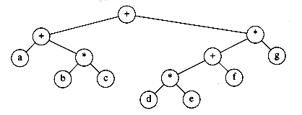
Expression tree for (a + b * c) + ((d * e + f ) * g)

Slide 16
Tree Traversal
Traversal is a process to visit all the nodes of a tree and may print their values.
Because, all nodes are connected via edges (links) we always start from the root node.
That is, we cannot random access a node in tree.
There are three ways which we use to traverse a tree
Pre-order Traversal
In-order Traversal
Post-order Traversal

Slide 17
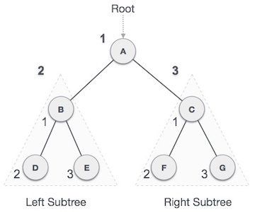
Preorder Traversal Algorithm
Until all nodes are traversed −
Step 1 − Visit root node and process.
Step 2 − Recursively traverse left subtree in preorder.
Step 3 − Recursively traverse right subtree in preorder.
The output of pre-order traversal of this tree will be −
A → B → D → E → C → F → G

Slide 18
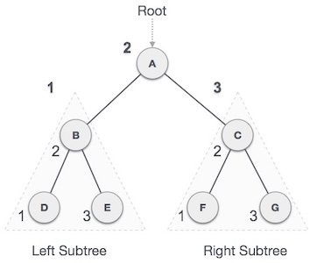
In-order Traversal Algorithm
Until all nodes are traversed −
Step 1 − Recursively traverse left subtree in in-oeder.
Step 2 − Visit root node and process.
Step 3 − Recursively traverse right subtree in in-order.
The output of in-order traversal of this tree will be −
D → B → E → A → F → C → G

Slide 19
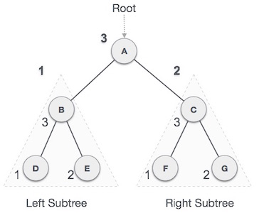
Post-order Traversal Algorithm
Until all nodes are traversed −
Step 1 − Recursively traverse left subtree in post-order.
Step 2 − Recursively traverse right subtree in post-order.
Step 3 − Visit root node and process.
The output of post-order traversal of this tree will be −
D → E → B → F → G → C → A

Slide 20
Examples on Tree Traversal

Slide 21
Creation of Binary Tree from Traversal sequence:
eg.1. Inorder- EACKFHDBG

Slide 22
Creation of Binary Tree from Traversal sequence:
eg.1. Inorder- EACKFHDBG
Preorder- FAEKCDHGB

Slide 23
Creation of Binary Tree from Traversal sequence:
eg.1. Inorder- EACKFHDBG
Preorder- FAEKCDHGB
Solu.
In preroder traversal root comes first. Hence F is root.
From Inorder traversal we can find left and right descendants. That is EACK and HDBG
Among EACK, A comes first in preorder, therefore A is root of left subtree.
Similarly in HDBG, D comes first in preorder hence D is root of right subtree.
And so on.

Slide 24
Eg.2 Inorder- BIDACGEHF and
Postorder- IDBGCHFEA
3. Preorder: G, B, Q, A, C, K, F, P, D, E, R, H
Inorder: Q, B, K, C, F, A, G, P, E, D, H, R

Slide 25
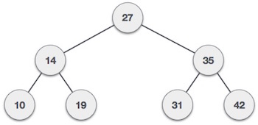
Binary Search Tree
A binary search tree (BST) is a tree in which all nodes has keys that follows the below mentioned properties −
All keys are distinct.
For every node X, in the tree, the values of all the keys in the left subtree are smaller than the key value in X.
For every node X, in the tree, the values of all the keys in the right subtree are greater than the key value in X.

Slide 26
Operations on Binary Search Tree
Initialize
Search
Find_min and find_max
Insert
Delete

Slide 27
Initialize(Make_null)
This operation is mainly for initialization.
Some programmers prefer to initialize the first element as a one-node tree, but our implementation follows the recursive definition of trees more closely.
It is also a simple routine,
struct node
{
int data;
struct node * left_ptr;
struct node * right_ptr;
};
Struct node * initialize ( void )
{
return NULL;
}

Slide 28
Search( Find)- search an element in a tree.
Whenever an element is to be search;
Start search from root node then if data is less than key value, search element in left subtree otherwise search element in right subtree.
This operation generally requires returning a pointer to the node in tree T that has key x, or NULL if there is no such node.

Slide 29
Non- recusive function
struct node* search(struct node * root,int n)
{
struct node *p = root;
while(p!=NULL)
{ if(p->data== n )
{ return (p); }
//go to right tree
if(n > p->data)
{
p=p->right_ptr;
}
//else go to left tree
else
{
p=p->left_ptr;
}
}
return NULL;
}

Slide 30
Recursive search() function
struct node* search(struct node * root,int n)
{
struct node *p = root;
while(p!=NULL)
{
if(n > p->data)
{
return(search(p->right_ptr, n));
}
else
if (n < p->data)
{
return(search(p->left_ptr, n));
}
else
return (p);
}
return NULL;
}

Slide 31
Insert Operation
Whenever an element is to be inserted.
First locate its proper location.
Start search from root node then if data is less than key value, search empty location in left subtree and insert the data.
Otherwise search empty location in right subtree and insert the data.

Slide 32
void insert(struct node * root, int n)
{
struct node *temp = (struct node*) malloc(sizeof(struct node));
struct node *current;
struct node *parent;
temp->data = n;
temp->left_ptr = NULL;
temp->right_ptr = NULL;
//if tree is empty
if(root == NULL)
{
root = temp;
}
else
{ current = root;

Slide 33
while(1)
{ parent = current;
//go to left of the tree
if(n < parent->data)
{ current = current->left_ptr;
//insert to the left
if(current == NULL)
{ parent->left_ptr = temp; return; }
}
//go to right of the tree
else
{ current = current->right_ptr;
//insert to the right
if(current == NULL)
{ parent->right_ptr = temp; return; }
}
}
}}

Slide 34
Create BST
BST can be created by using repeated insert operation.
eg. Create BST for following sequence
7 2 9 0 5 6 8 1

Slide 35
Delete
As is common with many data structures, the hardest operation is deletion.
Once we have found the node to be deleted, we need to consider several possibilities.
A leaf node
A node with one child
A node with two children

Slide 36
A leaf node
If the node is a leaf, it can be deleted immediately by setting the corresponding parent pointer to NULL.
20
20
10
30
10
30
8
40
15
8
40
15

Slide 37
A node with one child
If the node has one child, the node can be deleted after its parent adjusts a pointer to bypass the node.
20
20
10
30
10
30
8
8
15
40
15
35
35
32
38
32
38

Slide 38
A node with two children
The complicated case deals with a node with two children.
The general strategy is to replace the key of this node with the smallest key of the right subtree.
The smallest child in right subtree will either be leaf node or a node with single right child.
20
20
10
30
10
30
8
8
42
15
40
15
45
45
35
35
Node with
smallest value
In right subtree
50
50
42

Slide 39
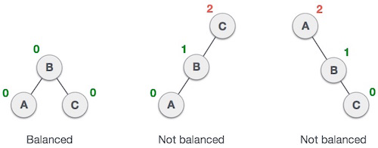
AVL Trees
An AVL (Adelson-Velskii and Landis) tree is a binary search tree with a height balance condition.
height balance condition
every node in the tree, the height of the left and right subtrees can differ by at most 1.
i.e. | height of left subtree – height right subtree | <= 1
This difference is called Balance Factor.

Slide 41
AVL Rotations
To make itself balanced, an AVL tree may perform four kinds of rotations −
Left rotation
Right rotation
Left-Right rotation
Right-Left rotation
First two rotations are single rotations and next two rotations are double rotations.

Slide 42
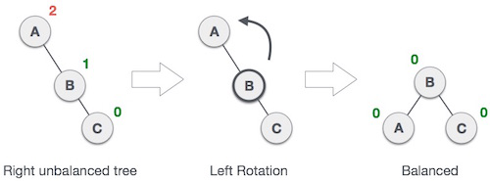
Left Rotation
If a tree become unbalanced, when a node is inserted into the right subtree tree, then we perform single left rotation,
Here, node A has become unbalanced as a node is inserted in right subtree of A's right subtree. We perform left rotation by making A left-subtree of B.

Slide 43
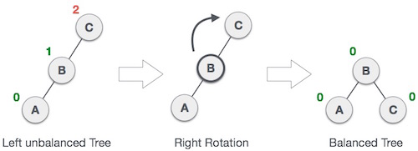
Right Rotation
AVL tree may become unbalanced if a node is inserted in the left subtree of tree. The tree then needs a right rotation.
The unbalanced node becomes right child of its left child by performing a right rotation.

Slide 44
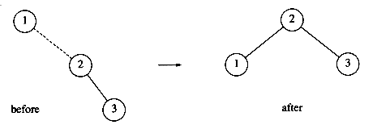
eg. Create AVL tree for sequence 1, 2, 3, 4, 5, 6, 7
Next, we insert the key 4, which causes no problems, but the insertion of 5 creates a violation at node 3, which is fixed by a left rotation.

Slide 45
Next, we insert 6. This causes a balance problem for the root.
The rotation is performed by making 2 a child of 4 and making 4's original left subtree the new right subtree of 2.

Slide 46
The next key we insert is 7, which causes another rotation.

Slide 47

Left-Right Rotation
Double rotations are slightly complex version of already explained versions of rotations.
A left-right rotation is combination of left rotation followed by right rotation.
A node has been inserted into right subtree of left subtree. This makes C an unbalanced node. These scenarios cause AVL tree to perform left-right rotation.

Slide 48
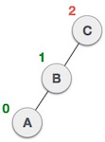
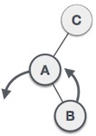
We first perform left rotation on left subtree of C.
This makes A, left subtree of B.

Slide 49
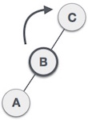
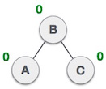
Node C is still unbalanced but now, it is because of left-subtree of left-subtree.
We shall now right-rotate the tree making B new root node of this subtree. C now becomes right subtree of its own left subtree.
The tree is now balanced.

Slide 50

Right-Left Rotation
It is a combination of right rotation followed by left rotation.
A node has been inserted into left subtree of right subtree.
This makes A an unbalanced node, with balance factor 2.

Slide 51
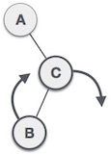
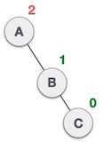
First, we perform right rotation along C node, making C the right subtree of its own left subtree B.
Now, B becomes right subtree of A.

Slide 52
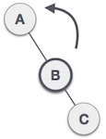
Node A is still unbalanced because of right subtree of its right subtree and requires a left rotation.
A left rotation is performed by making B the new root node of the subtree.
A becomes left subtree of its right subtree B.

Slide 53
Continuing our example, suppose we insert keys 8 through 15 in reverse order.
Inserting 15 is easy, since it does not destroy the balance property, but inserting 14 causes a height imbalance at node 7.
As the diagram shows, the single rotation has not fixed the height imbalance.

Slide 54
In our example, the double rotation is a right-left double rotation and involves 7, 15, and 14.
Here, k3 is the node with key 7, k1 is the node with key 15, and k2 is the node with key 14.

Slide 55
Next we insert 13, which requires a double rotation. Here the double rotation is again a right-left double rotation that will involve 6, 14, and 7 and will restore the tree.

Slide 56
If 12 is now inserted, there is an imbalance at the root. Since 12 is not between 4 and 7, we know that the single rotation will work.

Slide 57
Insertion of 11 will require a single rotation:

Slide 58
To insert 10, a single rotation needs to be performed, and the same is true for the subsequent insertion of 9.
We insert 8 without a rotation, creating the almost perfectly balanced tree that follows.

Slide 59
Threaded Binary Tree
The idea of threaded binary trees is to make inorder traversal faster and do it without stack and without recursion.
When a binary tree is represented using linked list representation, the reference part of the node which doesn't have a child is filled with a NULL pointer.

Slide 60
Threaded Binary Tree
In any binary tree linked list representation, there is a number of NULL pointers than actual pointers.
Generally, in any binary tree linked list representation, if there are 2N number of reference fields, then N+1 number of reference fields are filled with NULL (N+1 are NULL out of 2N).
This NULL pointer does not play any role except indicating that there is no link (no child).

Slide 61
Threaded Binary Tree
A. J. Perlis and C. Thornton have proposed new binary tree called "Threaded Binary Tree", which makes use of NULL pointers to improve its traversal process.
In a threaded binary tree, NULL pointers are replaced by references of other nodes in the tree. These extra references are called as threads.

Slide 62
Threaded Binary Tree
Threaded Binary Tree is also a binary tree in which all left child pointers that are NULL (in Linked list representation) or points to its in-order predecessor,
And all right child pointers that are NULL (in Linked list representation) or points to its in-order successor.
If there is no in-order predecessor or in-order successor, then it points to the root node.

Slide 63
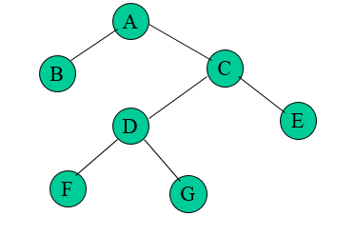
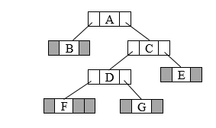
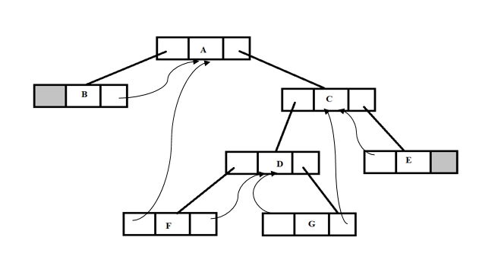
Threaded Binary Tree
Binary Tree
LL representation
Threaded Binary Tree

Slide 64
Threaded Binary Tree
Steps to convert binary tree into threaded tree:
Keep the leftmost and the rightmost NULL pointers as NULL because they will not have any predecessor or successor.
Change all other NULL pointers as:
Left Pointer ➔Inorder predecessor
Right Pointer ➔ Inorder successor

Slide 65
Threaded Binary Tree
Inorder traversal of the tree:
B-A-F-D-G-C-E

Slide 66
Threaded Binary Tree
Steps to convert binary tree into threaded tree:
Keep the leftmost and the rightmost NULL pointers as NULL because they will not have any predecessor or successor.
Change all other NULL pointers as:
Left Pointer ➔Inorder predecessor
Right Pointer ➔ Inorder successor
B-A-F-D-G-C-E

Slide 67
Structure Definition of node in Threaded Binary Tree
struct node { struct node *left; boolean lthread; int info; boolean rthread; struct node *right; };

Slide 68
Threaded Binary Tree
Advantages : Non-recursive pre-order, in-order and post-order traversal can be implemented without a stack. The node can keep record of its root. Disadvantages : Insertion and deletion operation becomes more difficult. Tree traversal algorithm becomes difficult. Memory required to store a node increases. Each node has to store the information whether the links is normal links or threaded links.

Slide 69
Multiway (M-Way) Tree
A multiway tree is defined as a tree that can have more than two children.
If a multiway tree can have maximum m children, then this tree is called as multiway tree of order m (or an m-way tree).
The properties of a non-empty m-way search tree of order m are:
Each node can hold maximum m-1 keys and can have maximum m children.
The keys in the node are in ascending order.
Keys in the non-leaf node will divide the left and right subtrees where value of left subtree keys will be less and value of right subtree keys will be more than that particular key.

Slide 70
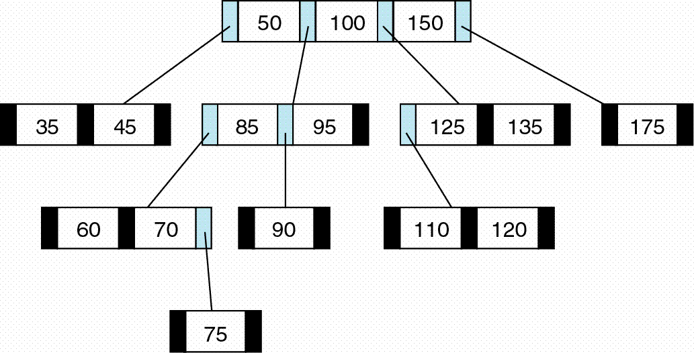
4-Way Tree

Slide 71
B Tree
B-Tree is a self-balancing search tree
Specialized m-way tree that can be widely used for disk access.
B-Tree of order m can have at most m-1 keys and m children.
Properties of B tree of order m similar to M way tree. In addition, it has following properties:
Every node in a B-Tree contains at most m children.
Every node in a B-Tree except the root node and the leaf node contain at least m/2 children.
The root nodes must have at least 2 nodes.
All leaf nodes must be at the same level.
It is not necessary that, all the nodes contain the same number of children but, each node must have m/2 number of nodes.

Slide 72
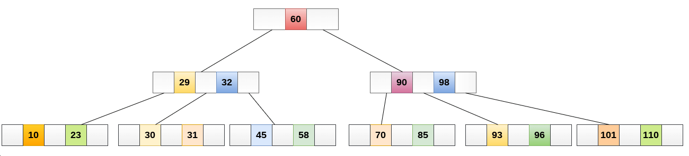
B Tree of order 4

Slide 73
Operations on B Tree
Searching :
Searching in B Trees is similar to that in Binary search tree. For example, if we search for an item 45 in the following B Tree.
Compare item 45 with root node 60. since 45 < 60 hence, move to its left sub-tree.
Since, 45> 32, traverse right sub-tree of 32.

Slide 74
Operations on B Tree
Insertion:
Insertions are done at the leaf node level.
The following algorithm needs to be followed in order to insert an item into B Tree.
Traverse the B Tree in order to find the appropriate leaf node at which the node can be inserted.
If the leaf node contain less than m-1 keys then insert the element in the increasing order.
Else, if the leaf node contains m-1 keys, then follow the following steps.
Insert the new element in the increasing order of elements.
Split the node into the two nodes at the median.
Push the median element upto its parent node.
If the parent node also contain m-1 number of keys, then split it too by following the same steps.

Slide 75
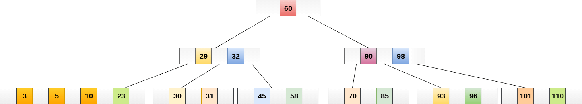
Operations on B Tree
Inserting : eg- Insert the node 8 into the B Tree of order 5 shown in the following image.

Slide 76
Operations on B Tree
Deletion :
The node which is to be deleted can either be a leaf node or an internal node.
Following algorithm needs to be followed in order to delete a node from a B tree.

Slide 77
Operations on B Tree
Deletion :
Locate the leaf node.
If there are more than m/2 keys in the leaf node then delete the desired key from the node.
If the leaf node doesn't contain m/2 keys then complete the keys by taking the element from reight or left sibling.
If the left sibling contains more than m/2 elements then push its largest element up to its parent and move the intervening element down to the node where the key is deleted.
If the right sibling contains more than m/2 elements then push its smallest element up to the parent and move intervening element down to the node where the key is deleted.
If neither of the sibling contain more than m/2 elements then create a new leaf node by joining two leaf nodes and the intervening element of the parent node.
If parent is left with less than m/2 nodes then, apply the above process on the parent too.

Slide 78
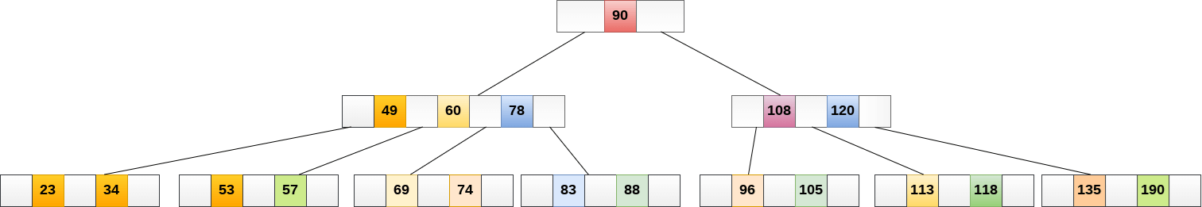
Operations on B Tree
Deletion :e.g. Delete the node 53 from the B Tree of order 5 shown below

Slide 79
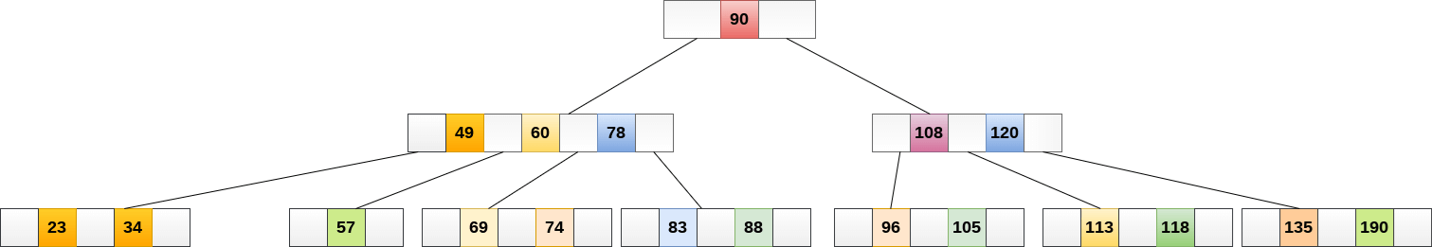
Operations on B Tree
Deletion :e.g. Delete the node 53 from the B Tree of order 5 shown below
Now, 57 is the only element which is left, the minimum number of elements that must be present in a B tree of order 5, is 2.
It is less than that, the elements in its left and right sub-tree are also not sufficient therefore, merge it with the left sibling and intervening element of parent i.e. 49.

Slide 80
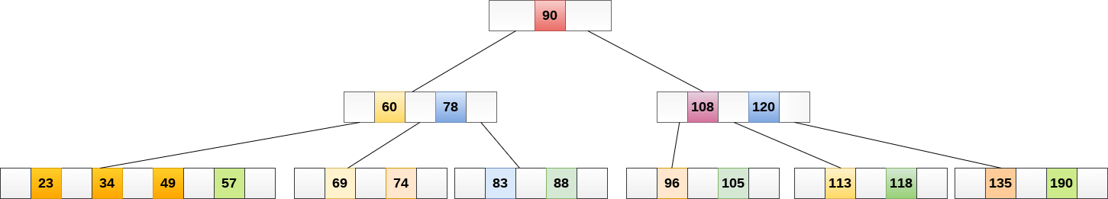
Operations on B Tree
Deletion :e.g. Delete the node 53 from the B Tree of order 5 shown below

Slide 81
Applications of B Tree
B tree is used to index the data and provides fast access to the actual data stored on the disks since, the access to value stored in a large database that is stored on a disk is a very time consuming process.
Searching an un-indexed and unsorted database containing n key values needs O(n) running time in worst case. However, if we use B Tree to index this database, it will be searched in O(log n) time in worst case.

Slide 82
B+ Tree
B+ Tree is an extension of B Tree which allows efficient insertion, deletion and search operations.
In B+ tree, records (data) can only be stored on the leaf nodes while internal nodes can only store the key values.
The leaf nodes of a B+ tree are linked together in the form of a singly linked lists to make the search queries more efficient.
B+ Trees are used to store the large amount of data which cannot be stored in main memory. The internal nodes (keys to access records) of the B+ tree are stored in the main memory whereas, leaf nodes are stored in the secondary memory.

Slide 83
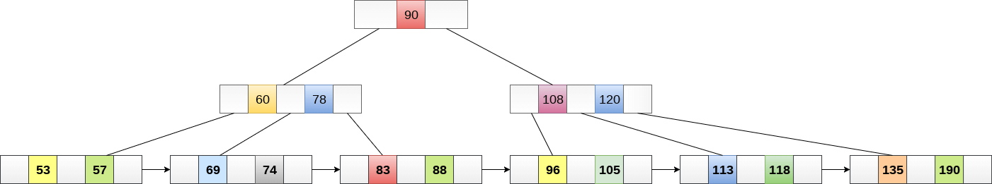
B+ Tree order 3

Slide 84
Advantages of B+ Tree
Records can be fetched in equal number of disk accesses.
Height of the tree remains balanced and less as compare to B tree.
We can access the data stored in a B+ tree sequentially as well as directly.
Keys are used for indexing.
Faster search queries as the data is stored only on the leaf nodes.

Slide 85
References
https://www.javatpoint.com/data-structure-tutorial
https://www.gatevidyalay.com/data-structures/
https://www.sanfoundary.com
https://tutorialspoint.com/cprogramming/c_structures.htm
https://www.geeksforgeeks.org/structures-c/

